Slide 1

Tabletop Torsion Device
Midterm Presentation I
By: Brendan Keane, Logan M^{c}Call, Reggie Scott, Mark Swain
Instructors: Dr. Scott Helzer and Dr. Nikhil Gupta
Sponsor: Mr. Philip Flater (Munitions Directorate Eglin AFB) Advisor: Dr. Simone Hruda

Slide 2
Overview
Background
Constraints
Statements
  Need Statement
  Goal Statement
Challenges and Considerations
  Breakdown
  Components
Plan of Action
  Gantt Chart
Conclusion
Logan McCall

Slide 3
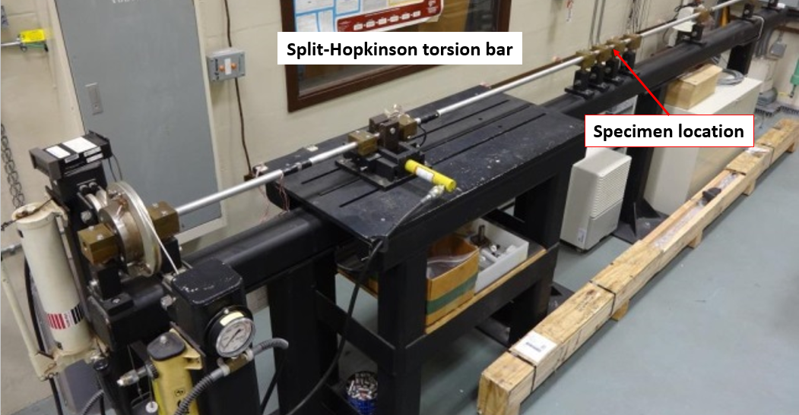
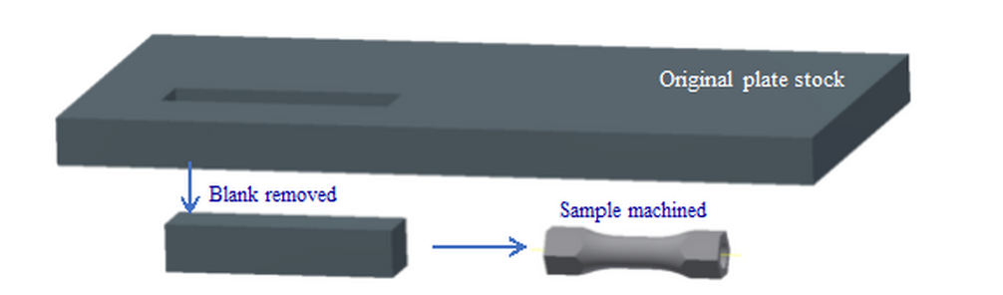
Background
Existing test hardware at Eglin AFB is not well-suited for characterizing relatively-small test samples that have been fabricated from plate or bar stock
  Current machine is generating low Signal to Noise Ratio (SNR)
  Has noticeable off axis loading
  Why not use larger specimens?
Figure 3.1: This is a representation of how the samples are machined
Figure 3.2: The 5m long machine that they are currently using to test the specimens, which runs at a max load of 2.3%
Logan McCall
Notes:
The reason for limited plate thickness is not a matter of cost, however it is a matter of geometry. When the Munitions Directorate is fabricating components of the munitions they use raw stock that is as close to final shape as possible to conserve waste material. In order to properly characterize the materials that end up in a product they have to simply test similar geometry in order the get accurate results.

Slide 4
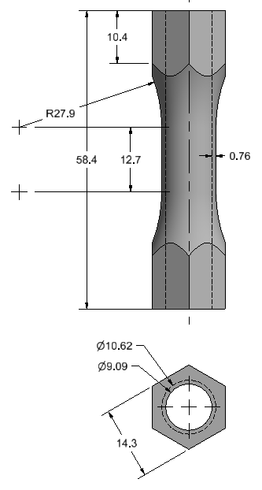
Constraints
Max load on specimen to max axial load ratio must be 20% or above
Minimum of 50Nm axial loading (Torque) by the machine
Budget - $2,000
Machine must fit in an area (footprint) of 0.75m x 1m
Monotonic(one direction), and Cyclic(two direction) Free-End Torsion Loading
Free-end has one degree of freedom(axial)
Must be compatible with the DIC
(Digital Imaging Correlation)
Figure 4: Specimen Dimensions (mm)
Logan McCall

Slide 5
Statements
Need Statement
  The current torsion machine at the Eglin Air Force Base is ineffective when testing small specimens.
Goal Statement
  Design a more effective way of testing small specimens in free-end torsion.
Logan McCall

Slide 6
Challenges and Considerations
How do we generate the torque?
How do we apply the torque to the sample?
How do we measure the torque applied?
How do we allow for the linear motion?
How do we house the device?
Logan McCall

Slide 7
Challenges and Considerations
Load Generation
Load Application
Load Measurement
Linear Motion
Housing
Logan McCall

Slide 8
Breakdown of Challenges
Torsion Tester
Load Generation
Manual Power
Load Measurement
Linear Motion
Sensors
Gripping Mechanism
Load Application
Friction Reduction
Motor & Transmission
User interface
Housing
Material Selection
User Safety
Logan McCall

Slide 9
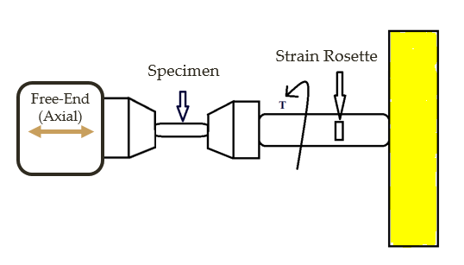
Load Generation
Manual Power
Motor
More cost effective
Higher accuracy and repeatability
User friendly
Programmable
Less complex design and manufacture
Less maintenance
Figure 9.1: Simple schematic showing fundamental aspects of design
Mark Swain

Slide 10
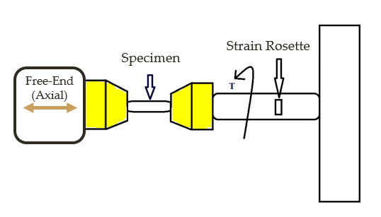
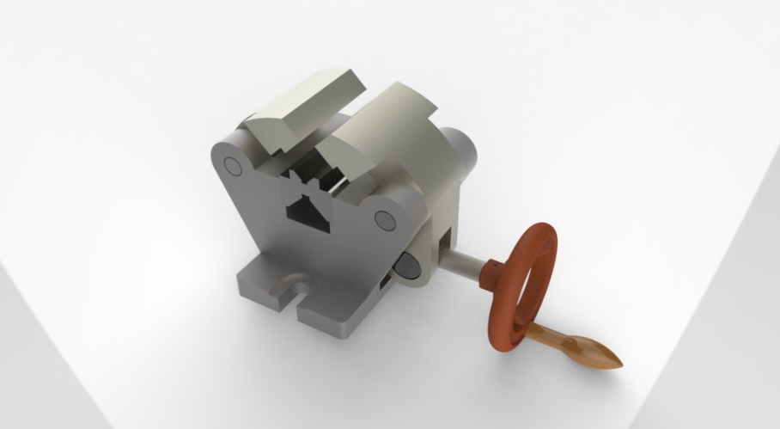
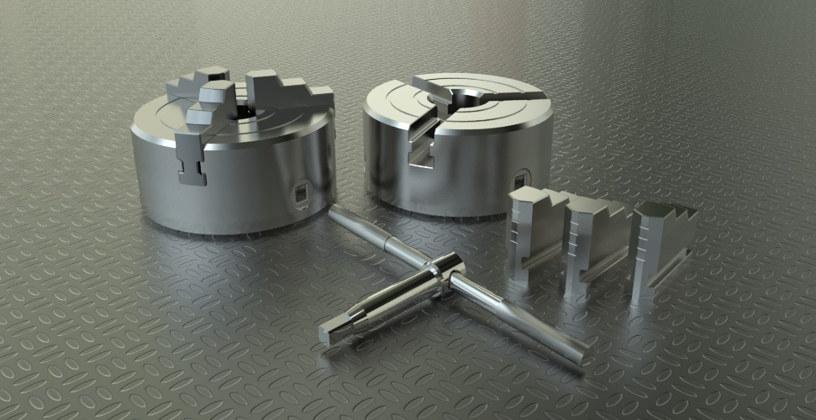
Load Application
Self-centering
How to prevent slip?
Figure 9.1: This figure represents a self- centering vise that could be used to hold the free end.
Figure 9.2: A cad rendering of a self-centering 3-jaw chuck commonly used on lathes.
Mark Swain

Slide 11
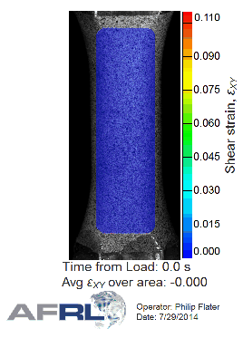
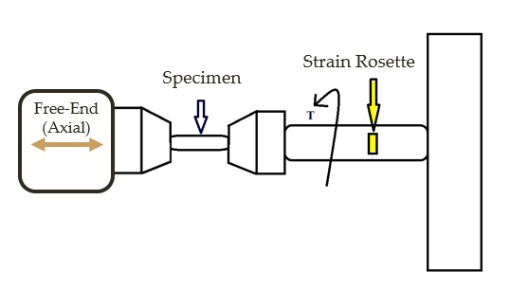
Load Measurement
DIC (Digital Image Correlation)
Strain Gauges (Strain Rosette)
Figure 10.2: Possible placement of strain gauges
Figure 10.1: Example DIC use in torsion sample
“DISTRIBUTION A: Approved for public release, distribution unlimited. (96ABW-2014-1649)”
Mark Swain

Slide 12
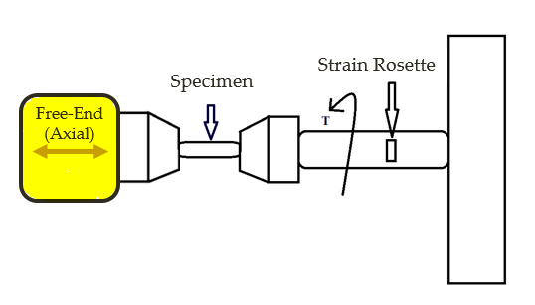
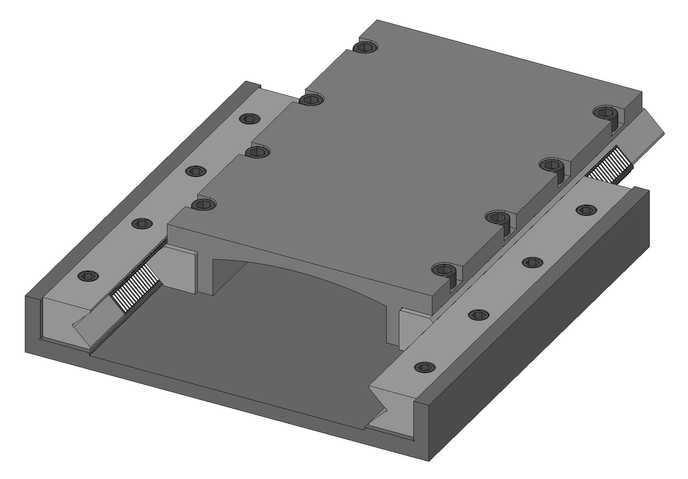
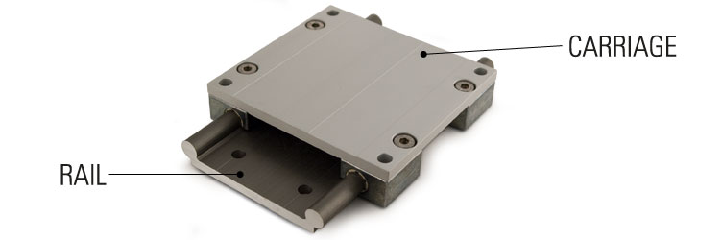
Linear Motion
Linear guide system
1DoF (Axial)
Bearings
  Orientation
  Selection
Figure 12.1: Possible ball bearing linear rail guide
Figure 12.2: Possible linear bearing rail guide
Mark Swain

Slide 13
Housing
Material Selection
User safety
Compatible with DIC and tabletop
Mark Swain

Slide 14
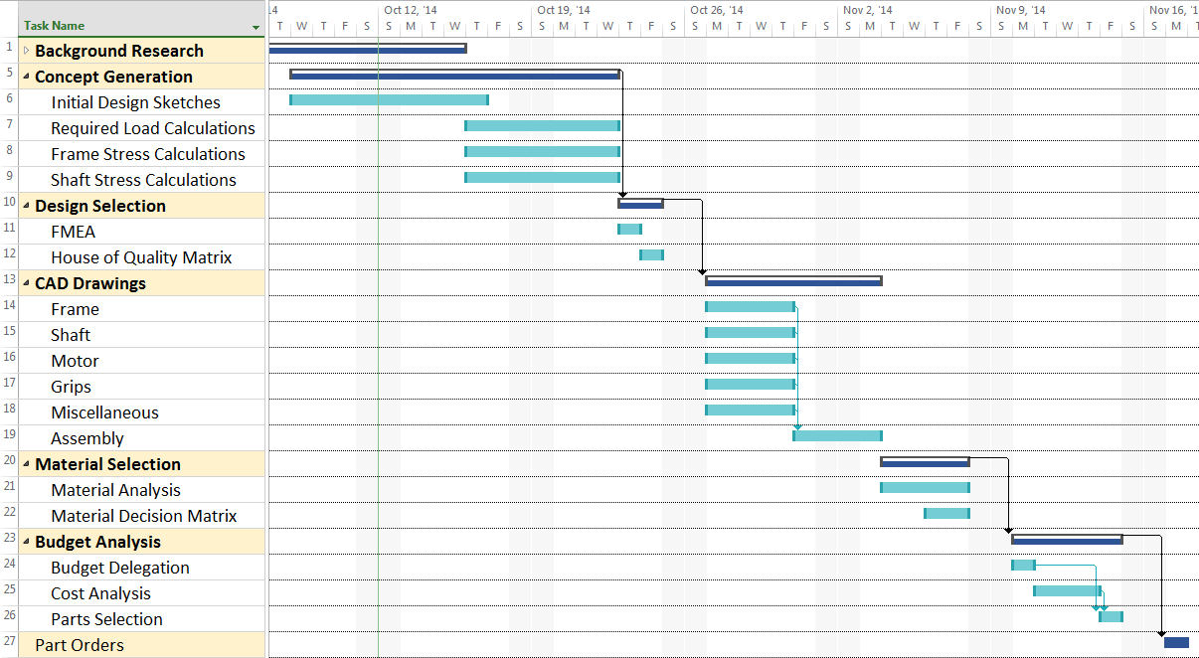
Plan of Action
Mark Swain

Slide 15
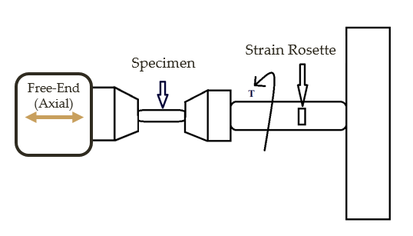
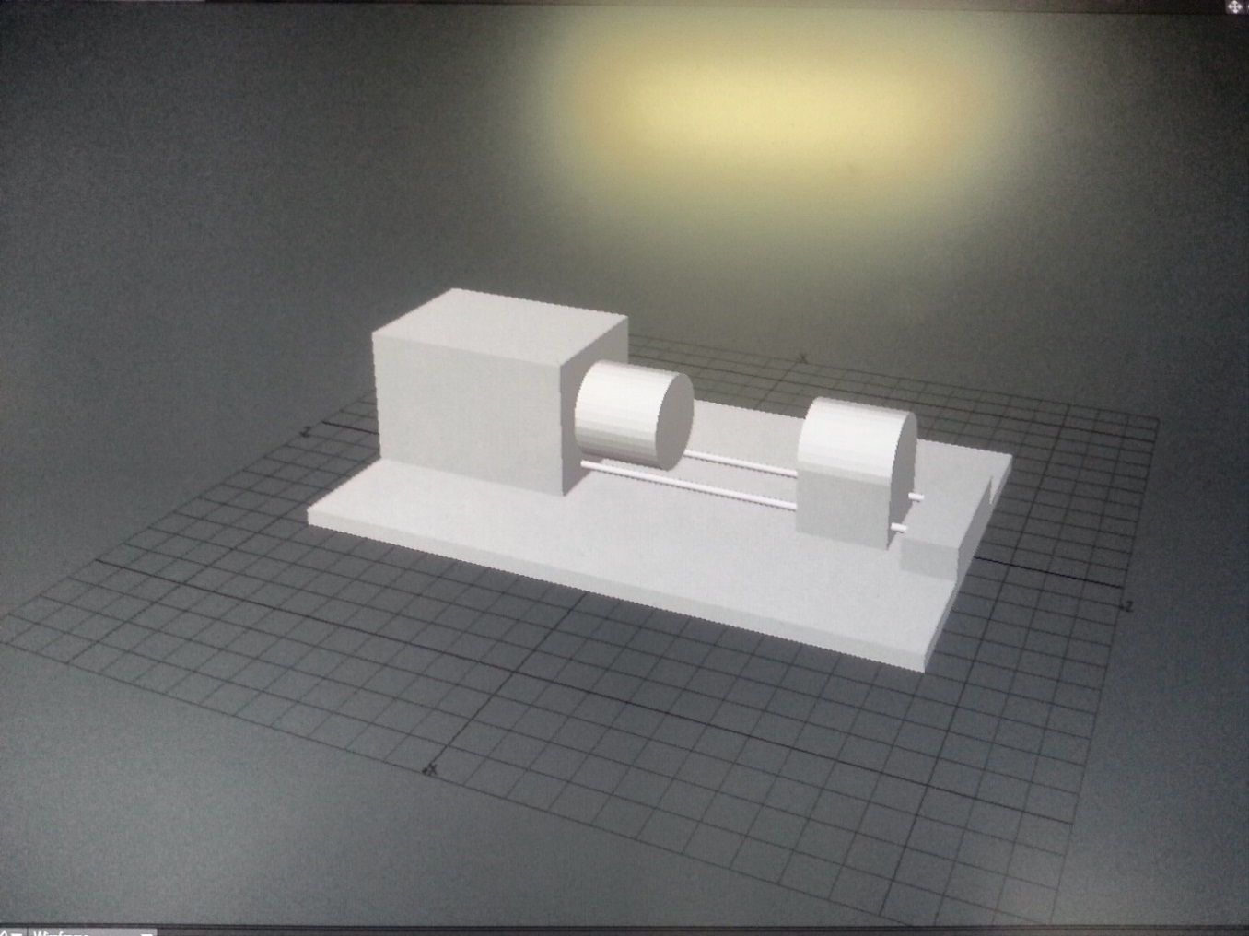
Conclusion
Goal Statement
  Design a more effective way of testing small specimens in free-end torsion.
Weighing options
  Load Generation
  Load Application
  Load Measurement
  Linear Motion
  Housing
Next Phase
Figure 15: This rendering was created in Lightwave’s Modeler. It was created just to get an understanding of the fundamental components that we will be working with.
Mark Swain
Notes:
Completion of initial design sketches- Preliminary calculations- Design selection for full CAD build- Full CAD build

Slide 16
Questions?

Slide 17
References
Carter, B. (2008). Texas Instruments: Op Amp Noise Theory and Applications. Retrieved September 22, 2014
Flater, P. (2014). Tabletop Torsion Test. Eglin, FL: Air Force Research Laboratory.
Ilic, M. (2014, October 11). Clamp for centering. Retrieved from GRABCAD: https://grabcad.com/library/stega-za-centriranje-clamp-for-centering-1
Lathe Chuck. (2014, October 7). Retrieved from GRABCAD: https://grabcad.com/library/lathe-chuck-3
Linear Motion Systems. (2014, September 28). Retrieved from Stock Drive Products: https://sdp-si.com/eStore/coverpg/linearmotion.htm
Mark Swain

Slide 18
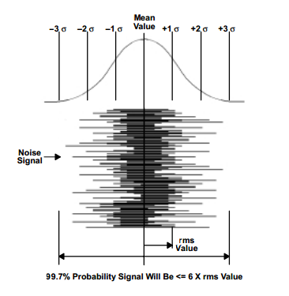
What is SNR?
Group 13

Slide 19
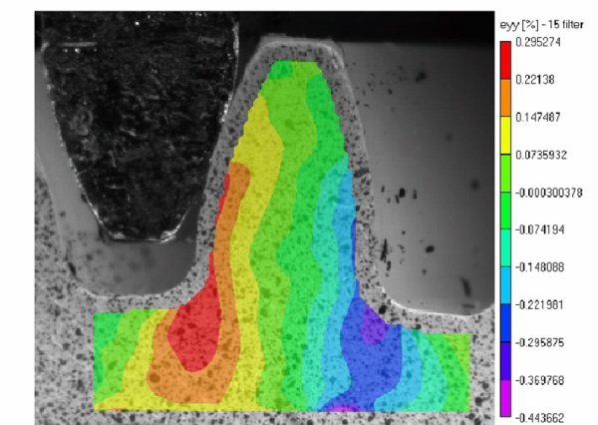
What is DIC?
Group 13

